Slide 1
運用優先權與無耐性之區塊鏈交易模型研究 A Study on Blockchain Transaction Models with Priority and Impatience
指导教授： 钟顺平 教授
研 究 生： 蔡怡翔
公元 2025 年 0 月 0 日

Slide 2
Outline
Motivation
System Model
Analytical Model
Numerical Results
Conclusions and Future Works

Slide 3
Outline
Motivation
System Model
Analytical Model
Numerical Results
Conclusions and Future Works

Slide 4
Motivation
Blockchain is a foundational infrastructure for digital trust and decentralized system
Decentralization, transparency, and immutability
Bit coin, finance healthcare media logistics energy
Interoperability → Cross-chain bridges
Notes:
區塊鏈目前已迅速發展成為數位信任與去中心化系統的基礎架構。
有著去中心化、透明性與不可篡改性等特性，適用於資料的安全儲存。
區塊鏈原先設計用於支持比特幣等加密貨幣，但如今已廣泛應用於金融、醫療、媒體、物流與能源等多個領域。
然而，當今區塊鏈技術面臨的一項重大挑戰是「跨鏈互通性」，也就是讓獨立運作的區塊鏈網路之間能夠互相溝通與交換資產或資訊。
為解決此問題，開發出了「跨鏈橋接（cross-chain bridges）」

Slide 5
Motivation
In [2], apply M/M/n/L queues modeling transaction processing and block generation in Bitcoin
Queue length / block generation rate
In [7], Blockchain queuing model with non-preemptive limited-priority is proposed.
In [10], Queueing model for cross-chain transaction flows is presented.

Slide 6
Motivation
Two sequential queues: customer queue and block queue
Customer queue: waiting to be selected for block formation
Block queue: undergoing consensus
ON / OFF mechanism
Partial batch service
Capture realistic life
Non-preemptive priority
Impatience

Slide 7
Outline
Motivation
System Model
Analytical Model
Numerical Results
Conclusions and Future Works

Slide 8
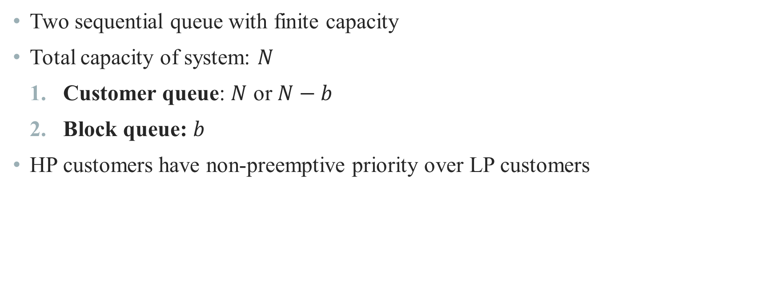
System Model
Two sequential queue with finite capacity
Total capacity of system: $N$
Customer queue: $N$ or $N−b$
Block queue: $b$
HP customers have non-preemptive priority over LP customers

Slide 9
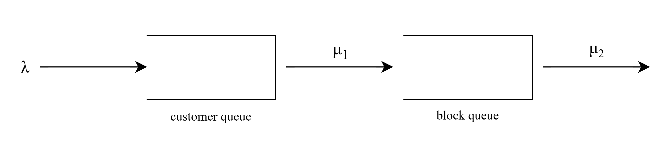




System Model
Total capacity = $N$
$$N$$
num in block queue = 0
$$N−b$$
$$0\sim b$$
num in block queue > 0
9

Slide 10
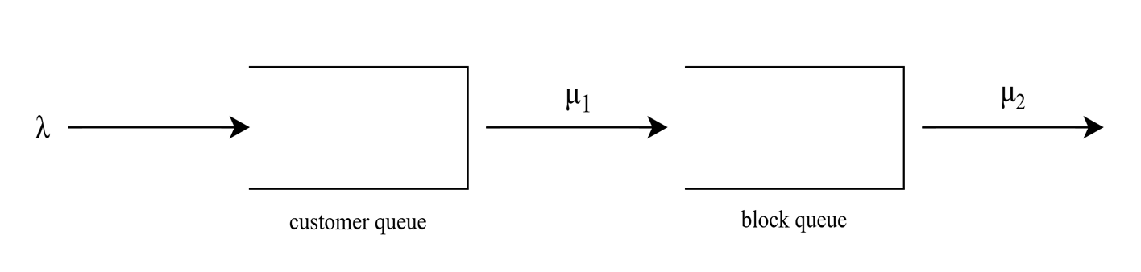

System Model
Scenario 2
Scenario 1
Scenario 3
Scenario 4
H
L
H
2
1
block
LP block
$$γ$$

Slide 11
Outline
Motivation
System Model
Analytical Model
Numerical Results
Conclusions and Future Works

Slide 12
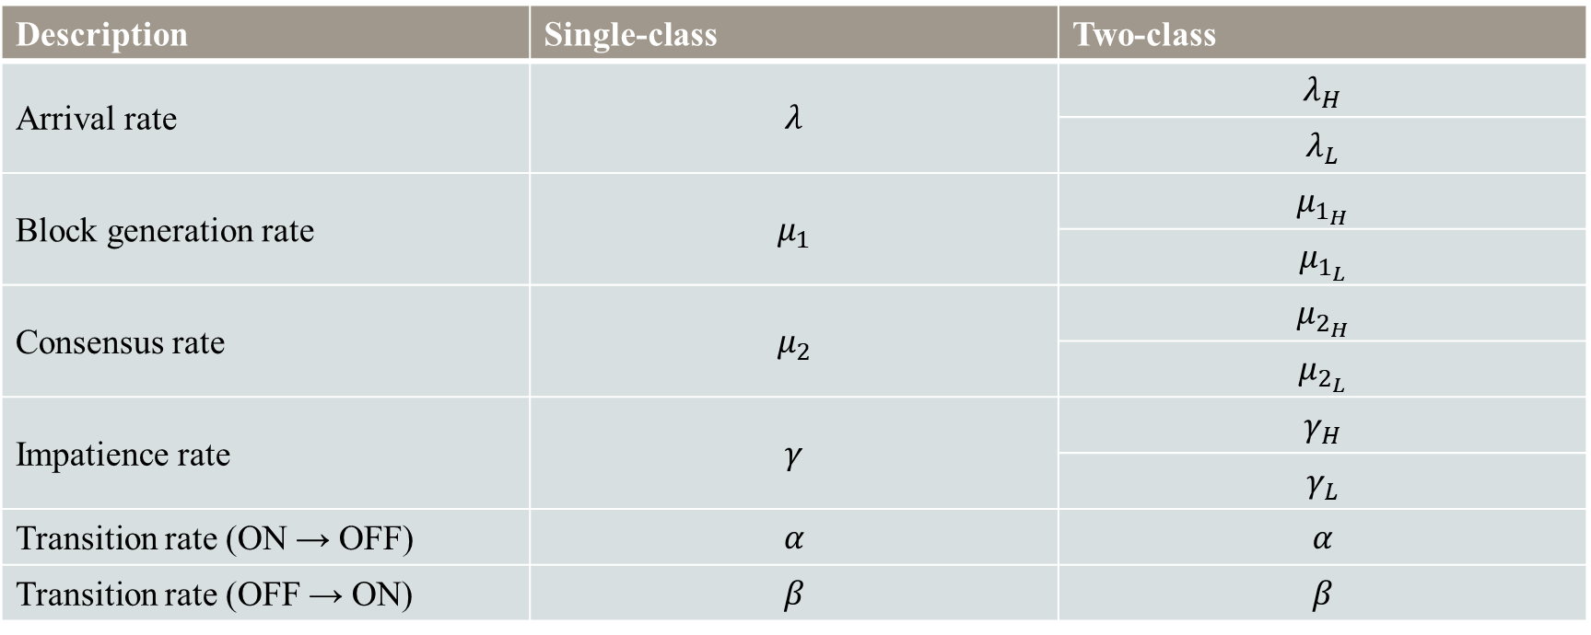
Analytical Model
Description | Single-class | Two-class
Arrival rate | $$λ$$ | $$λ_{H}$$
 |  | $$λ_{L}$$
Block generation rate | $$μ_{1}$$ | $$μ_{1_{H}}$$
 |  | $$μ_{1_{L}}$$
Consensus rate | $$μ_{2}$$ | $$μ_{2_{H}}$$
 |  | $$μ_{2_{L}}$$
Impatience rate | $$γ$$ | $$γ_{H}$$
 |  | $$γ_{L}$$
Transition rate (ON → OFF) | $$α$$ | $$α$$
Transition rate (OFF → ON) | $$β$$ | $$β$$

Slide 13
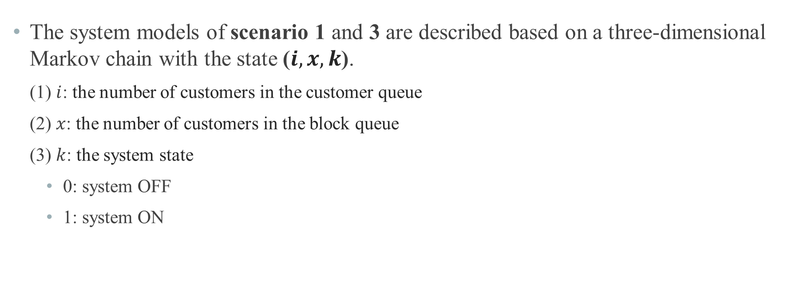
Analytical Model
The system models of scenario 1 and 3 are described based on a three-dimensional Markov chain with the state ($i, x, k$).
(1) $i$: the number of customers in the customer queue
(2) $x$: the number of customers in the block queue
(3) $k$: the system state
0: system OFF
1: system ON

Slide 14
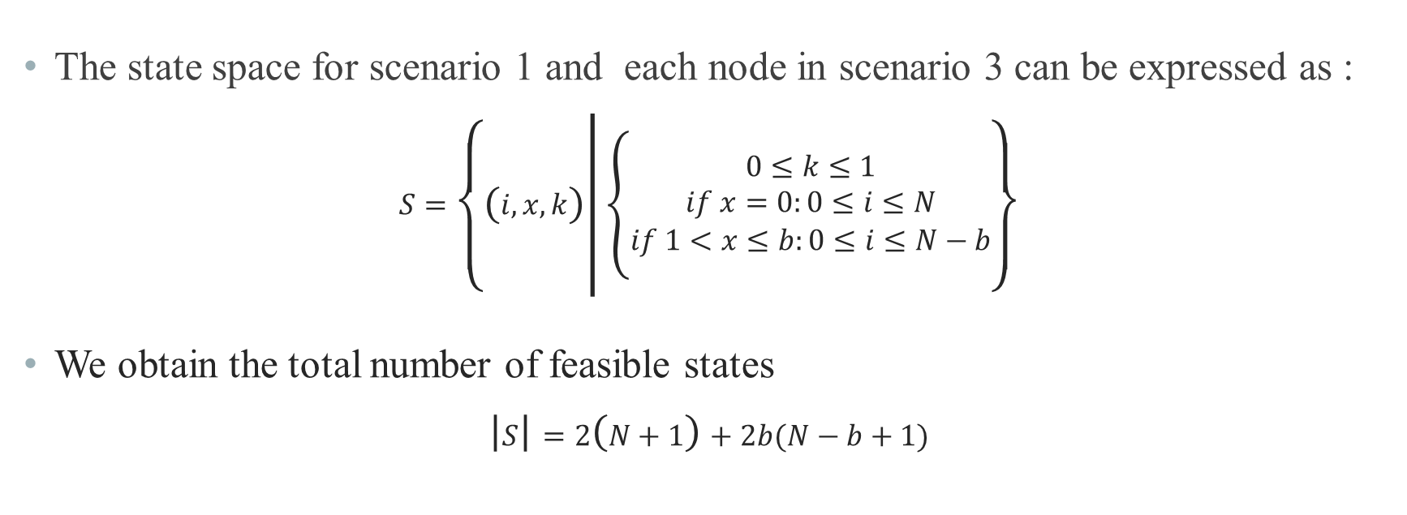
Analytical Model
The state space for scenario 1 and each node in scenario 3 can be expressed as :
$$S=\left\{\left(i, x, k\right) | \left\{\begin{aligned}0≤k≤1 \\ if x=0:0≤i≤N \\ if 1<x≤b:0≤i≤N−b\end{aligned}\right.\right\}$$
We obtain the total number of feasible states
$$\left|S\right|=2\left(N+1\right)+2b(N−b+1)$$

Slide 16

Analytical Model
The system models of scenario 2 and 4 are described based on a five-dimensional Markov chain with the state ($i,j,x, y,k$).
(1) $i$: the number of customers in the customer queue
(2) $x$: the number of customers in the block queue
(3) $k$: the system state
0: system OFF
1: system ON

Slide 17
Analytical Model
The state space for scenario 1 and each node in scenario 3 can be expressed as :
$$S=\left\{\left(i, x, k\right) | \left\{\begin{aligned}0≤k≤1 \\ if x=0:0≤i≤N \\ if 1<x≤b:0≤i≤N−b\end{aligned}\right.\right\}$$
We obtain the total number of feasible states
$$\left|S\right|=2\left(N+1\right)+2b(N−b+1)$$

Slide 18
Outline
Motivation
System Model
Analytical Model
Numerical Results
Conclusions and Future Works

Slide 19
Outline
Motivation
System Model
Analytical Model
Numerical Results
Conclusions and Future Works

Slide 21
Thank you for listening

